Slide 1
IT APPLICATION ICA 3
Valerie, Shermaine, Sharmane, and Harika

Slide 2
INTRODUCTION
We strive to enhance Pizza Hut's business with solutions to ensure customer satisfaction, increased sales, and a productive environment to meet Pizza Hut's business needs

Slide 3
Business Needs
What are some of Pizza Hut’s business needs?

Slide 4
01
FREQUENT STOCKOUT

Slide 5
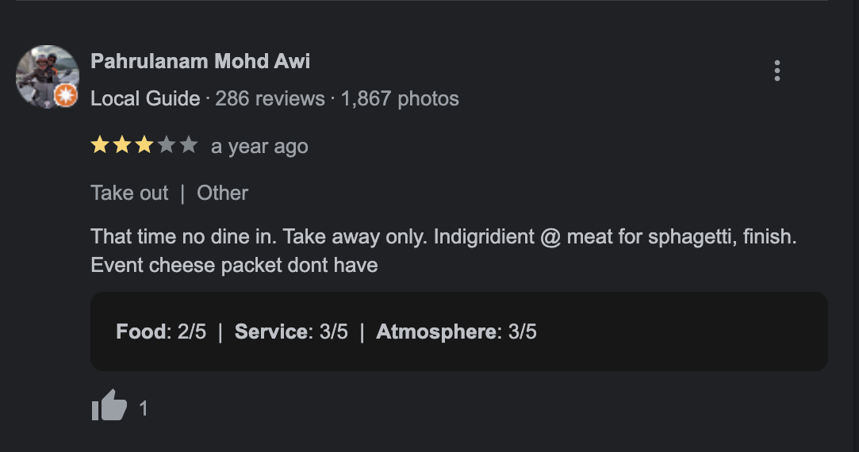
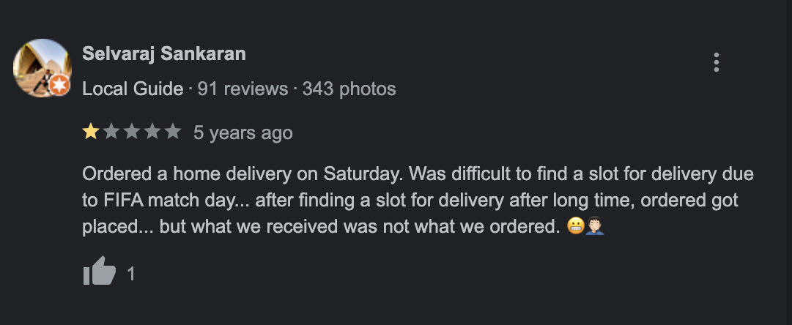
Problems
Customers experience unmet needs due to frequently out-of-stock items
Often stemming from insufficient ingredient availability

Slide 6
02
DELIVERY

Slide 7
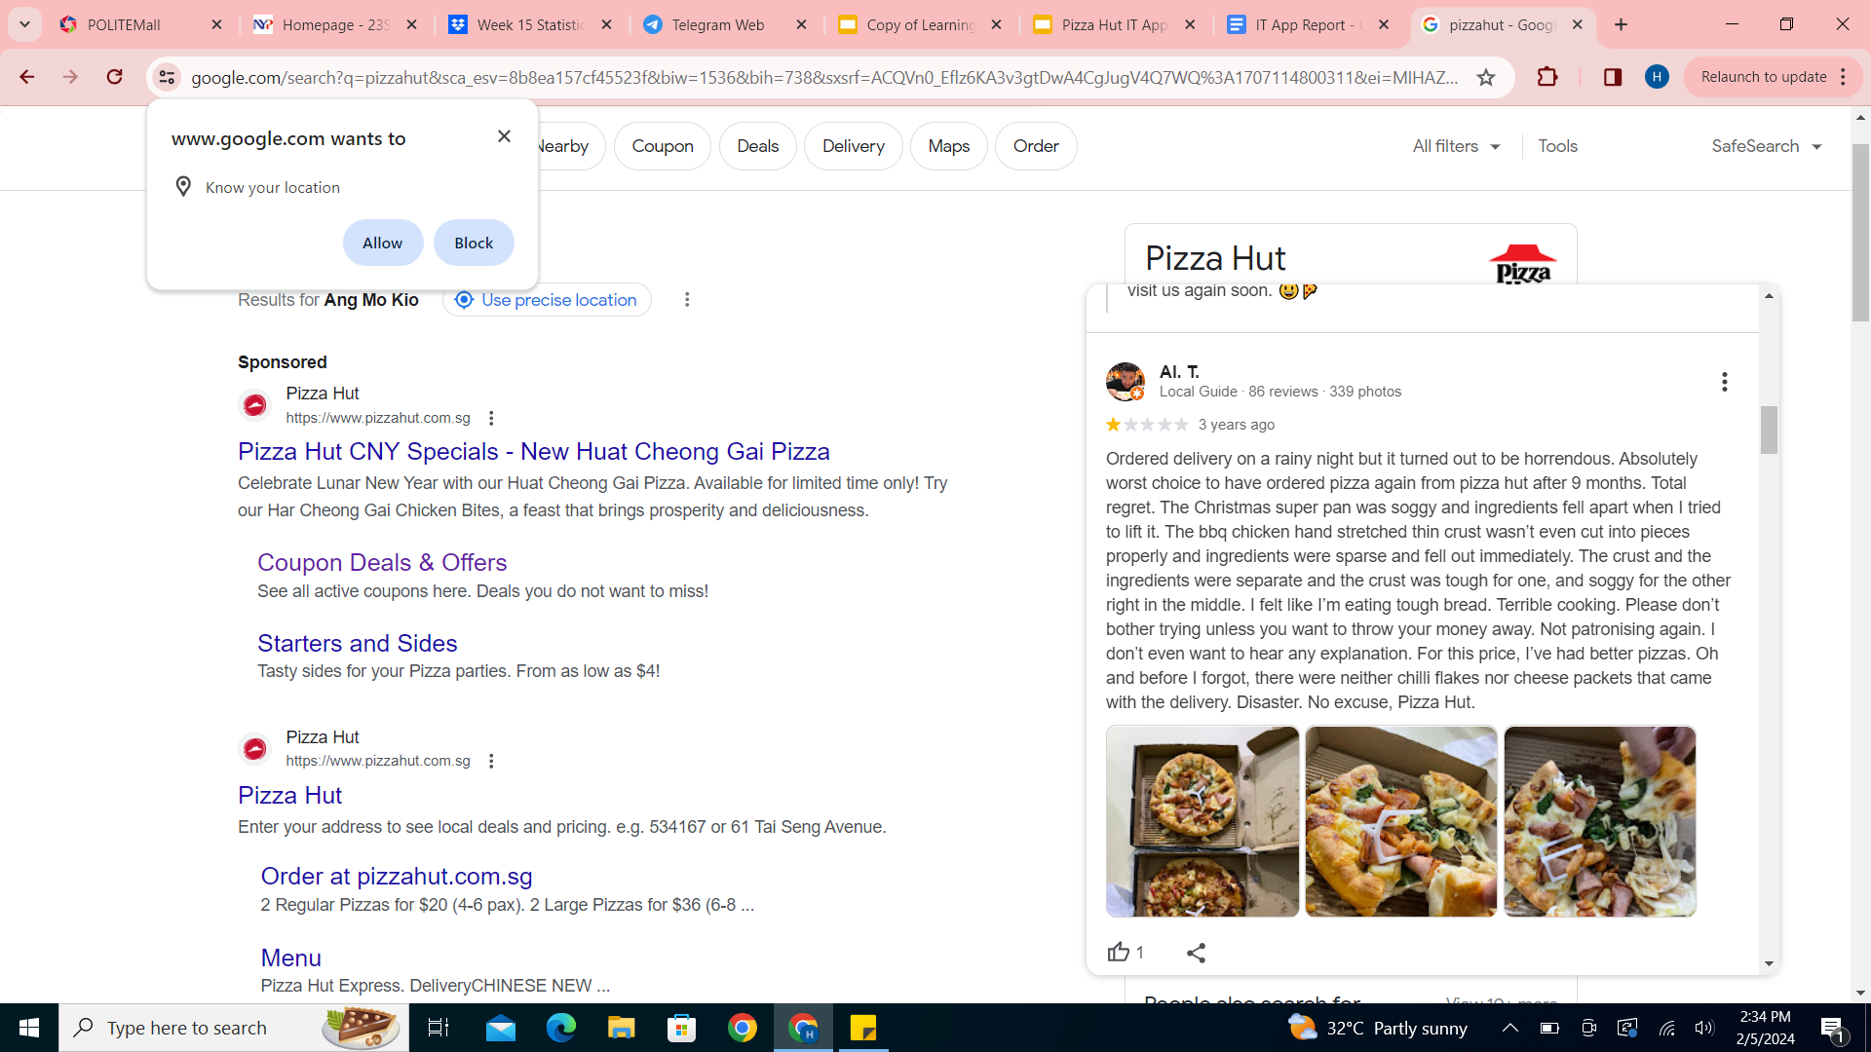
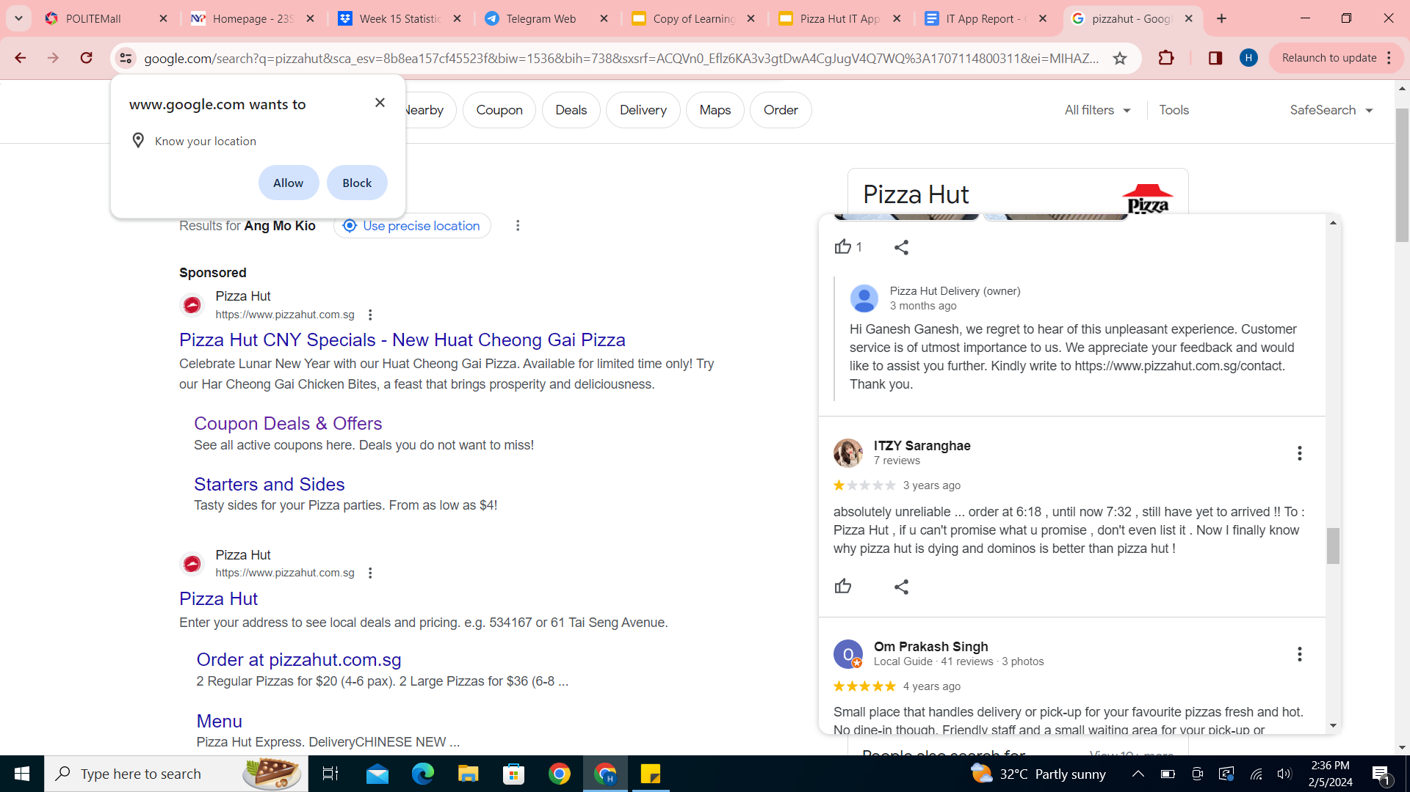
Problems
Numerous customers express dissatisfaction with prolonged delivery times, citing soggy pizzas due to delays
Led to significant customer attrition for Pizza Hut (bad reviews)

Slide 8
03
INEFFICIENT ORDER
MANAGEMENT

Slide 9
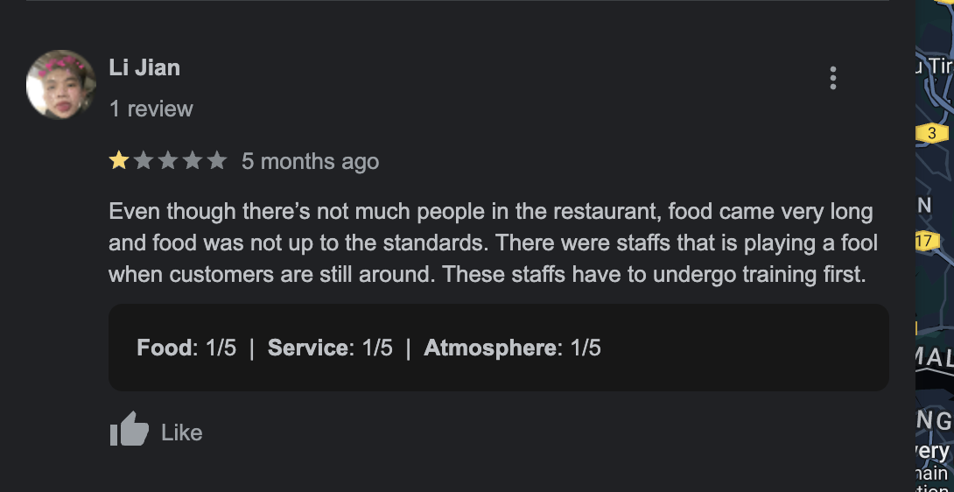
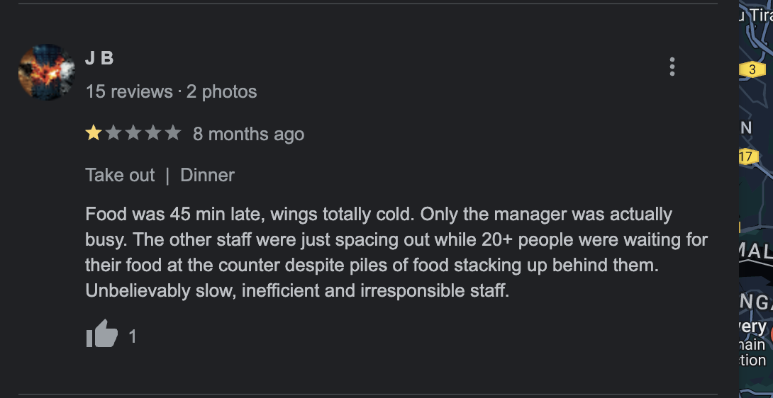
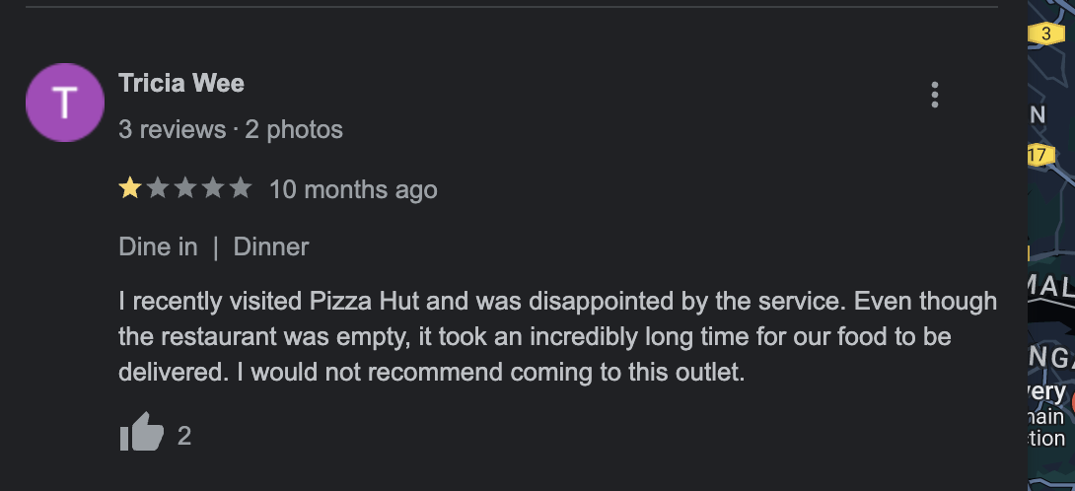
Problems
Numerous customers have raised concerns about prolonged order wait times
Often attributed to a shortage of available manpower

Slide 10
04
INCONSISTENCY
ACROSS STORES

Slide 11
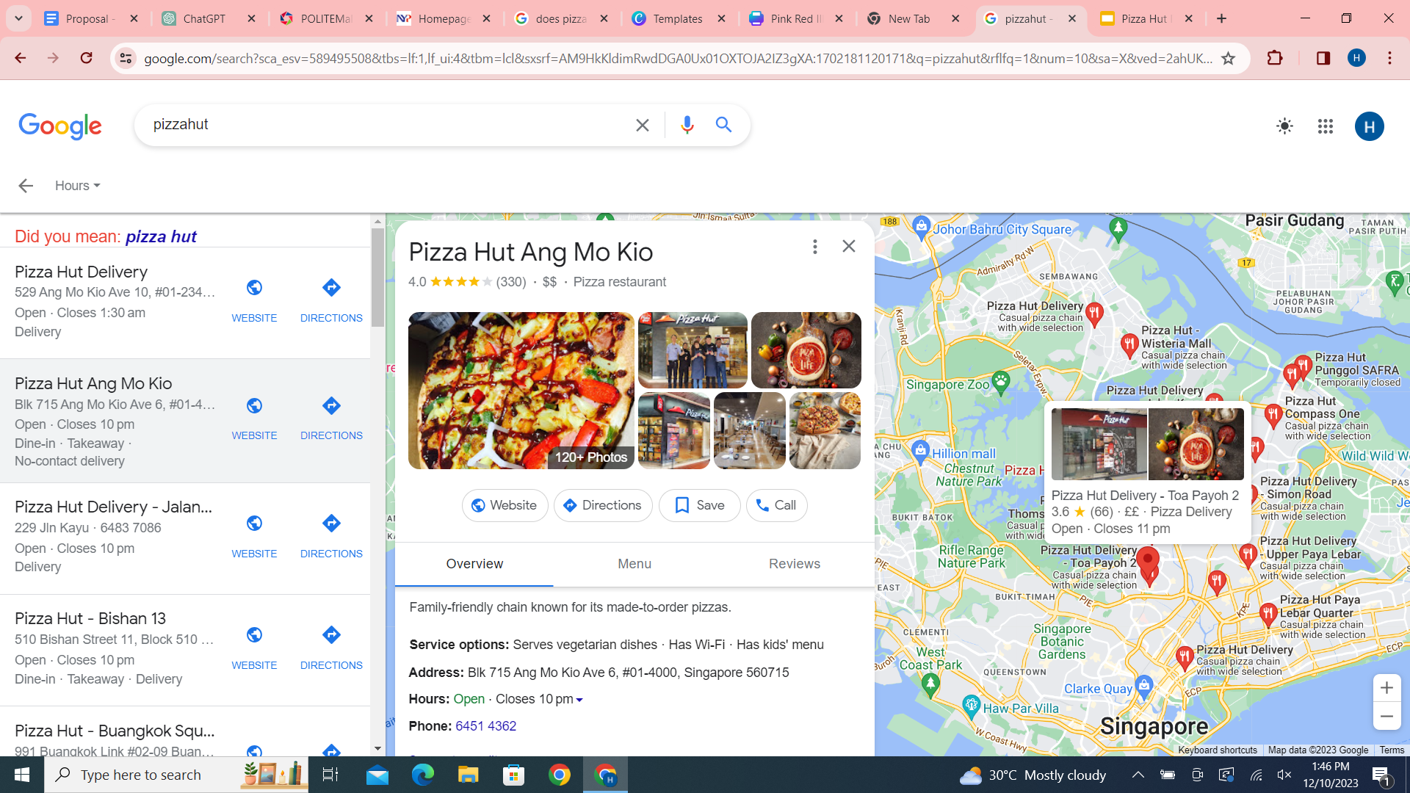
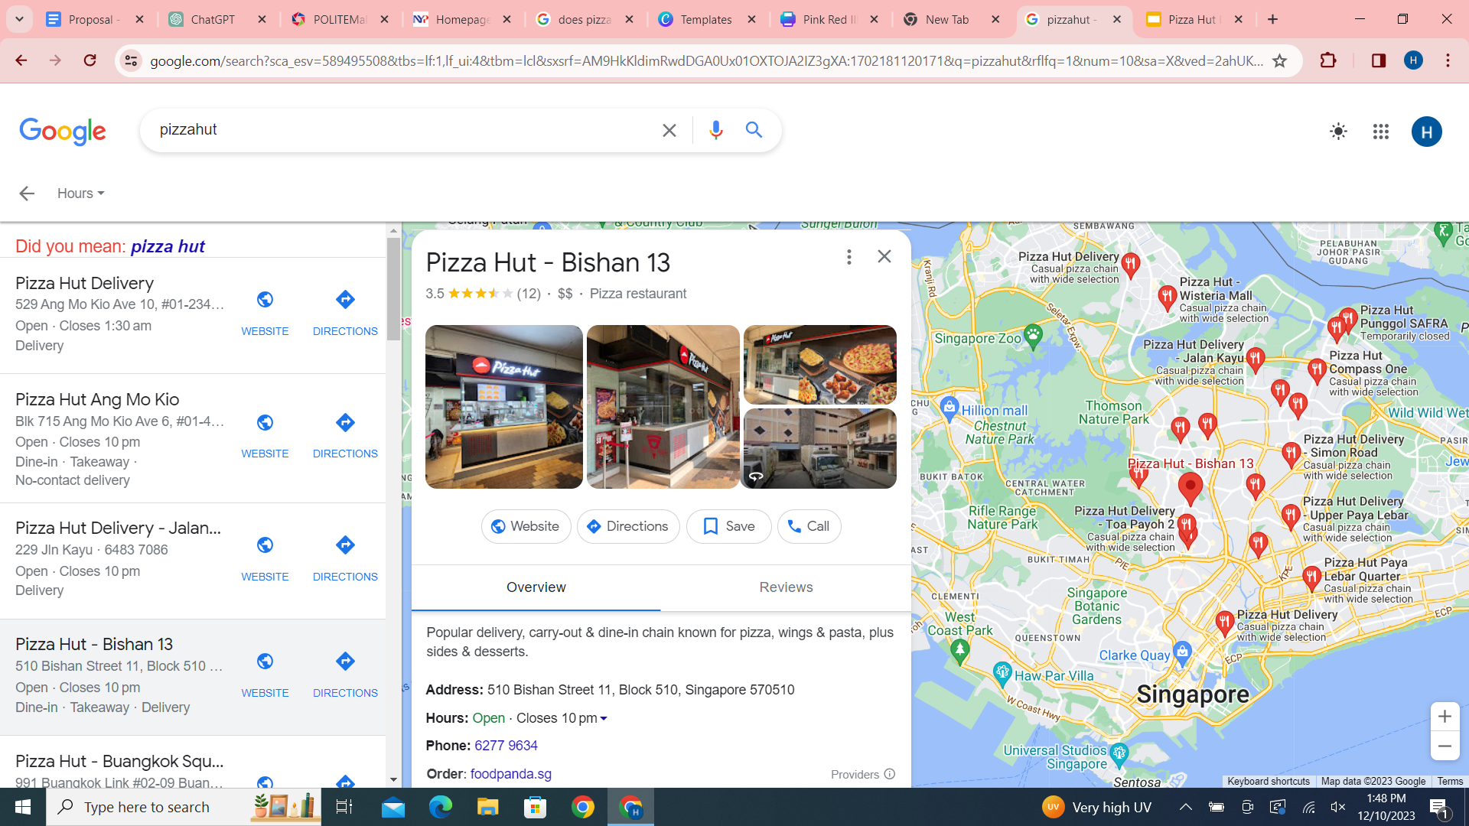
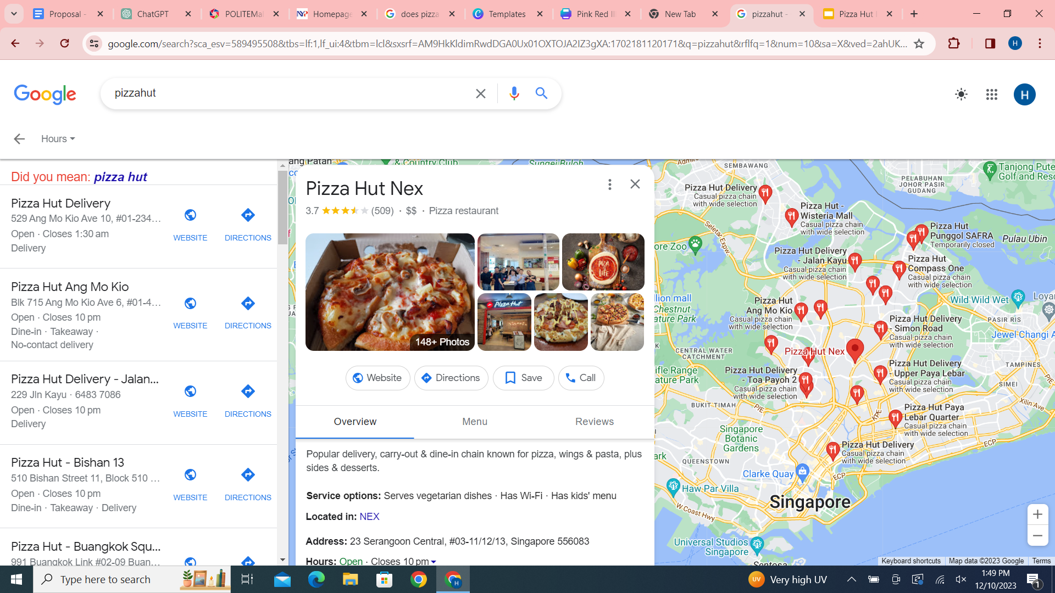
Problems
While each outlet features an identical menu, the quality of both food and services varies significantly
Adversely affect customer satisfaction and the overall performance of the store

Slide 12
SDLC METHOD- WATERFALL
Analyze problems
Make requirements for scratch applications
Design four scratch applications separately
Create scratch applications
Test scratch applications
Integrate all scratch applications together
Deploy scratch application to Github

Slide 13
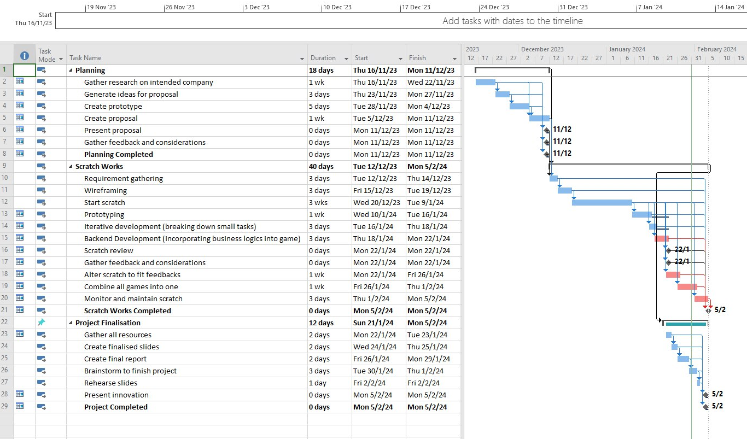
Microsoft Project

Slide 14
Scratch

Slide 15
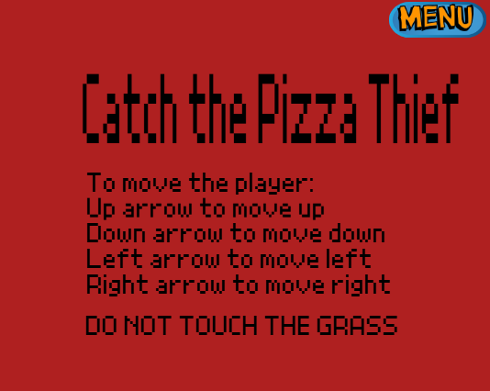
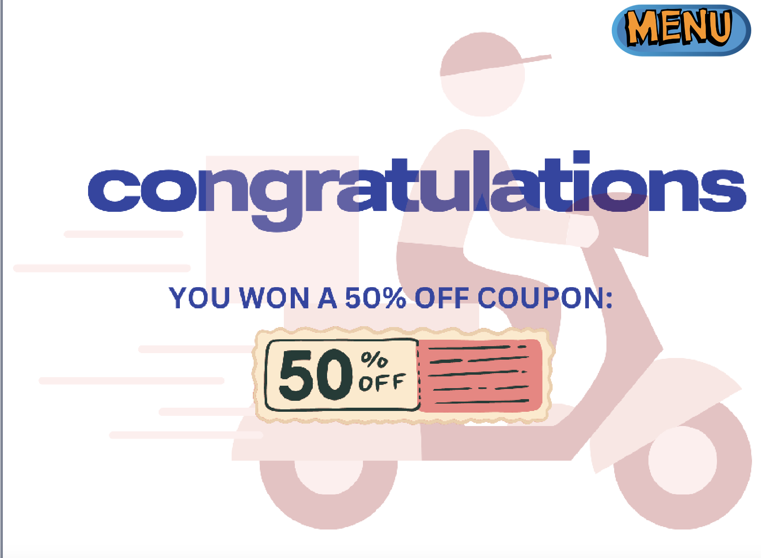
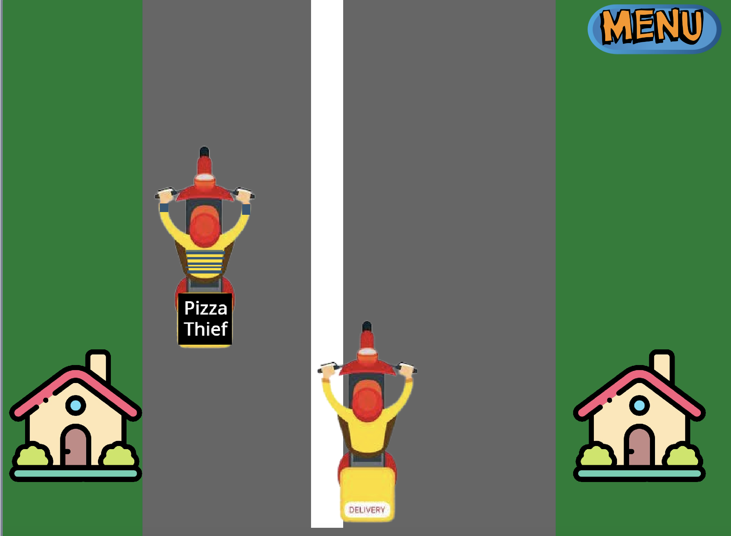
Solution 1 (Delivery Game)

Slide 16
Solution 1 (Delivery Game)
Creating an illusion:
Enables customers to win coupons while waiting their food
Simplified version to let older people order directly from Pizza Hut
Keeps customers engaged while waiting for delivery and gives the perception that the delivery time is shorter
Coupons in the game allow the customers to be repeat customers because many do not want to waste the coupon
Increases the amount of purchases and revenue for Pizza Hut

Slide 17
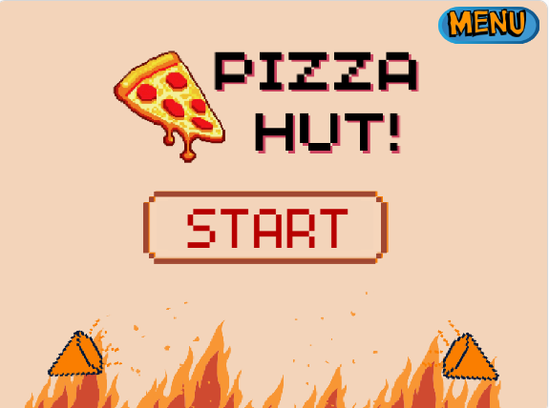
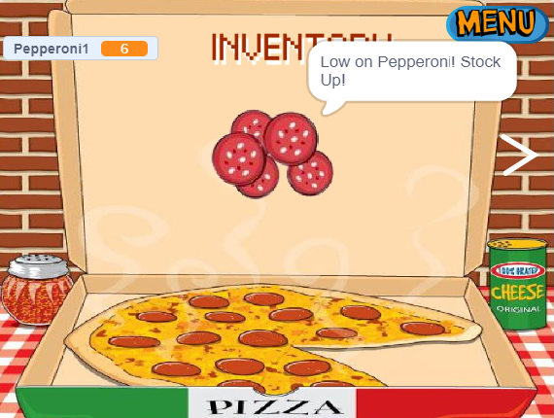
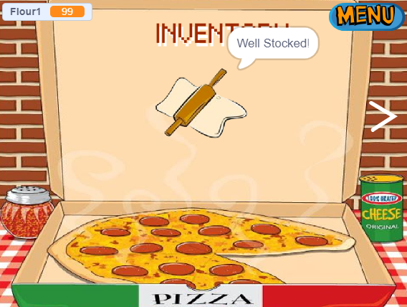
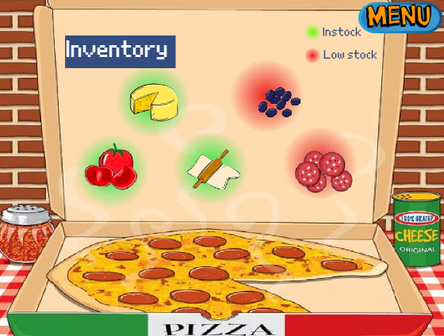
Solution 2 (Inventory Tracking)

Slide 18
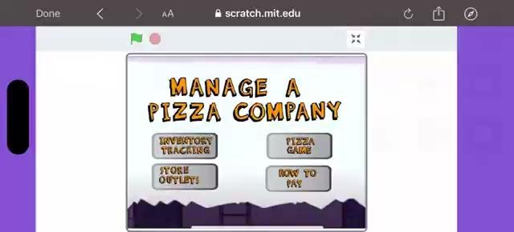
Solution 2 (Inventory Tracking)

Slide 19
Solution 2 (Inventory Tracking)
Managing Inventory
Staffs will be notified when a certain product is out of stock
Minimises risk of stockout which will affect customers and consequently the sales of Pizza Hut
Utilizing visuals and gamification to make it interactive and dynamic for staffs to use
Keeps employees engaged in their tasks
Improves Pizza Hut’s efficiency and allows staff to focus on other important tasks

Slide 20
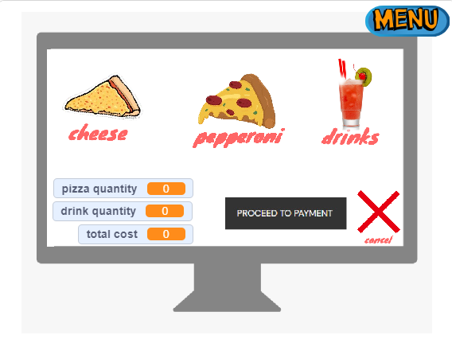
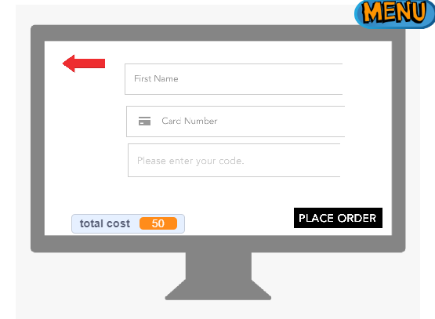
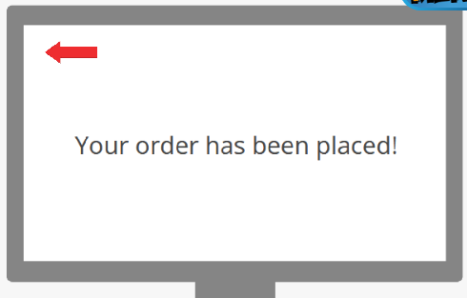
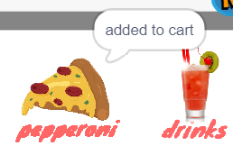
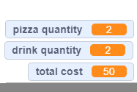
Solution 3 (How to Pay)

Slide 21
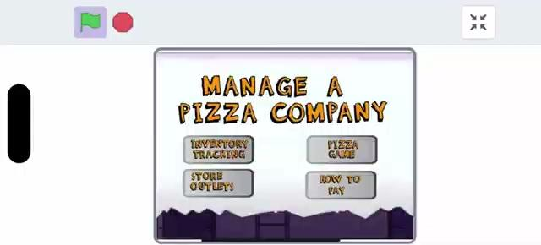
Solution 3 (How to Pay)

Slide 22
Solution 3 (How to Pay)
Creating a simulation
By creating a simulation of how the ordering process will be carried out
Firstly showing how the amount of items and prices would be added together.
Then showing how you have to input your personal informations
And showing how the price would change when you input the discount code

Slide 23
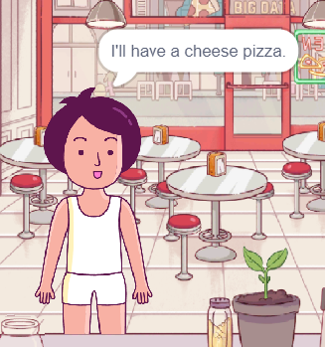
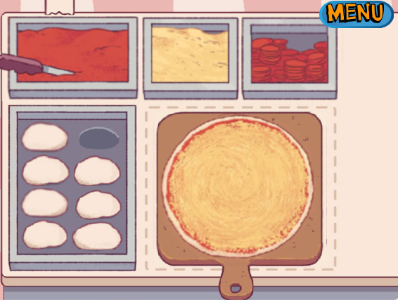
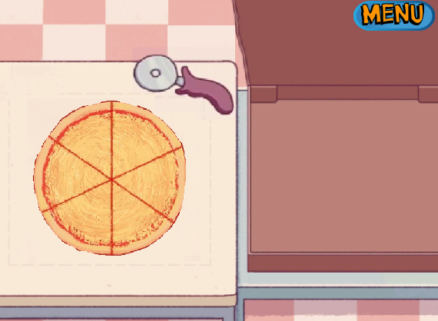
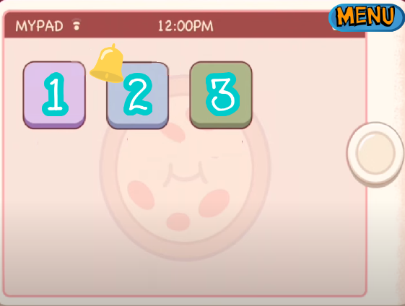
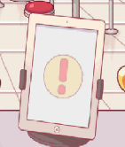
Solution 4 (Pizza Outlets)

Slide 24
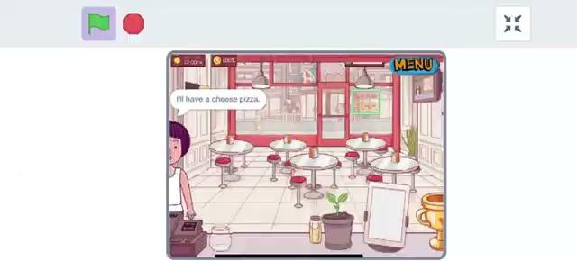
Solution 4 (Pizza Outlets)

Slide 25
Solution 4 (Pizza Outlets)
Interactive Learning: Educating staffs in an engaging and interactive way by incorporating a pizza-making game into training
Consistency: Ensure all staff members adhere to this procedure regardless of location = customers receive the same high-quality experience

Slide 26
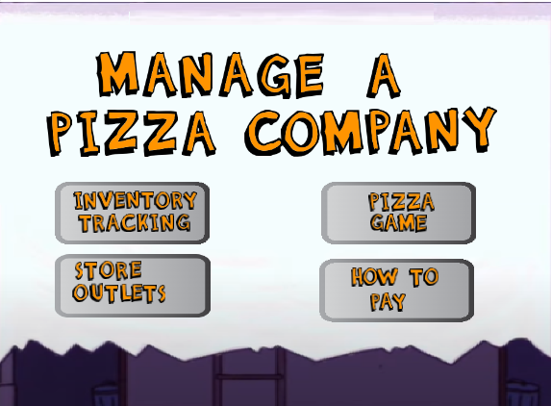
Integrating all 4 scratches

Slide 27
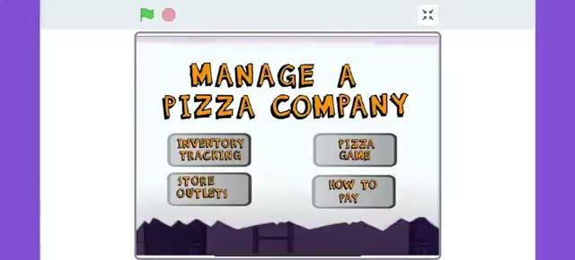
Integrating all 4 scratches

Slide 28
Game Demo!
https://scratch.mit.edu/projects/961298280

Slide 29
Thank You!

Slide 30
ALTERNATIVE RESOURCES

